Slide 1



ML/DL for Everyone with
Lecture 6:
Logistic Regression
Sung Kim <hunkim+ml@gmail.com> HKUST
Code: https://github.com/hunkim/PyTorchZeroToAll
Slides: http://bit.ly/PyTorchZeroAll

Slide 2

Call for Comments
Please feel free to add comments directly on these slides.
Other slides: http://bit.ly/PyTorchZeroAll
Picture from http://www.tssablog.org/archives/3280

Slide 3
ML/DL for Everyone with
Lecture 6:
Logistic Regression
Sung Kim <hunkim+ml@gmail.com> HKUST
Code: https://github.com/hunkim/PyTorchZeroToAll
Slides: http://bit.ly/PyTorchZeroAll

Slide 4

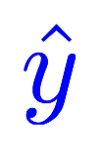
Linear model
Linear
Hours (x) | Points
1 | 2
2 | 4
3 | 6
4 | ?
Notes:
\hat{y}=x*w+b

Slide 5

Binary prediction (0 or 1) is very useful!
Spent N hours for study, pass or fail?
GPA and GRE scores for the HKUST PHD program, admit or not?
Soccer game against Japan, win or lose?
She/he looks good, propose or not?
…

Slide 6
Linear to binary (pass/fail, 0/1)
Linear
Hours (x) | Points
1 | 2
2 | 4
3 | 6
4 | ?
fail/pass
0
0
1
?
Notes:
\hat{y}=x*w+b

Slide 7
Logistic regression: pass/fail (0 or 1)
Linear
Linear
Sigmoid
Hours (x) | Points
1 | 2
2 | 4
3 | 6
4 | ?
fail/pass
0
0
1
?
Notes:
\hat{y}=x*w+b

Slide 8
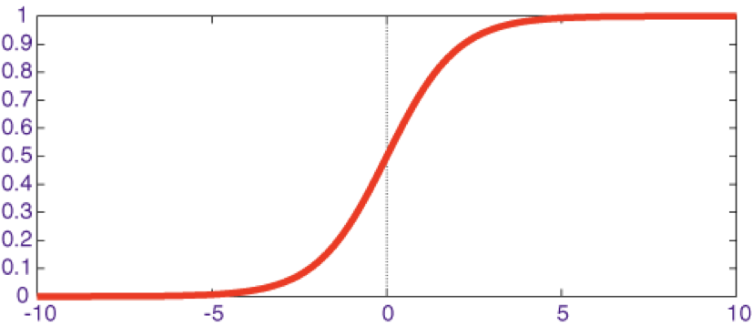
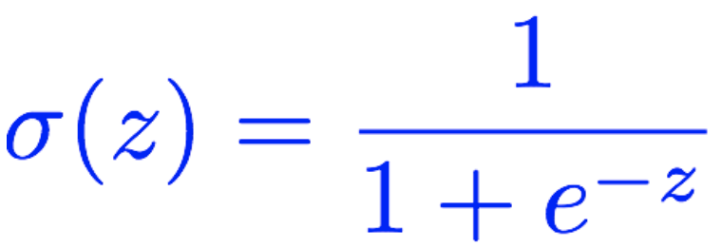
Meet Sigmoid
Linear
Linear
Sigmoid
Hours (x) | Points
1 | 2
2 | 4
3 | 6
4 | ?
fail/pass
0
0
1
?
Notes:
\hat{y}=x*w+b

Slide 9

Meet Sigmoid
Linear
Linear
Sigmoid
Hours (x) | Points
1 | 2
2 | 4
3 | 6
4 | ?
fail/pass
0
0
1
?
Notes:
\hat{y}=x*w+b

Slide 10


Meet sigmoid
Linear
Linear
Sigmoid
Hours (x) | Points
1 | 2
2 | 4
3 | 6
4 | ?
fail/pass
0
0
1
?
Notes:
\hat{y}=x*w+b
loss = \frac{1}{N}\sum_{n=1}^{N} y^{(n)} \log \hat{y}^{(n)} + (1 - y^{(n)}) \log (1-\hat{y}^{(n})

Slide 11
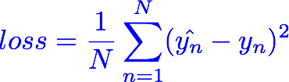
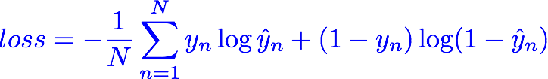
Meet Cross Entropy Loss
Linear
Linear
Sigmoid
Hours (x) | Points
1 | 2
2 | 4
3 | 6
4 | ?
fail/pass
0
0
1
?
Notes:
\hat{y}=x*w+b
loss = \frac{1}{N}\sum_{n=1}^{N} y^{(n)} \log \hat{y}^{(n)} + (1 - y^{(n)}) \log (1-\hat{y}^{(n})

Slide 12
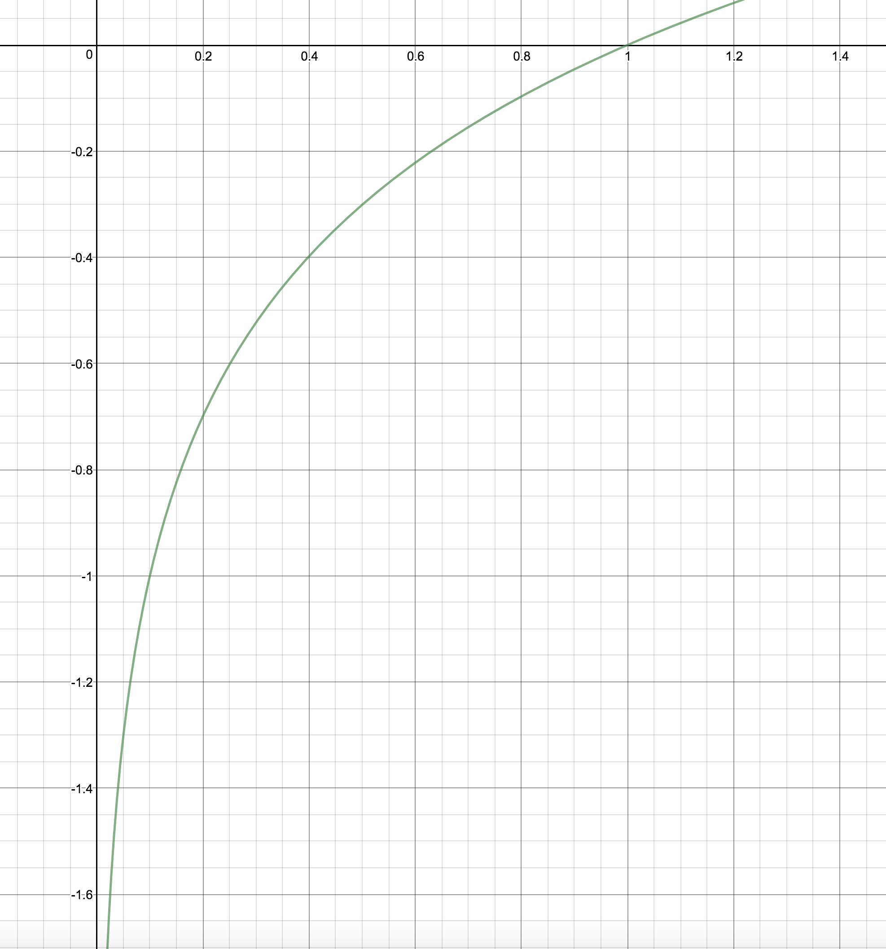
(Binary) Cross Entropy Loss
z
y | y_pred | loss
1 | 0.2
1 | 0.8
0 | 0.1
0 | 0.9
log(z)
Notes:
\hat{y}=x*w+b
loss = \frac{1}{N}\sum_{n=1}^{N} y^{(n)} \log \hat{y}^{(n)} + (1 - y^{(n)}) \log (1-\hat{y}^{(n})

Slide 13

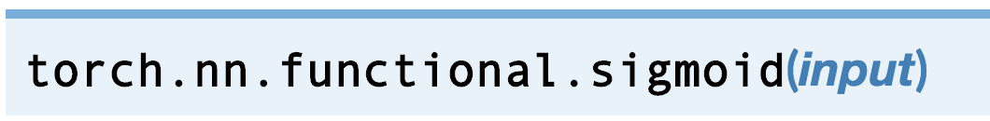
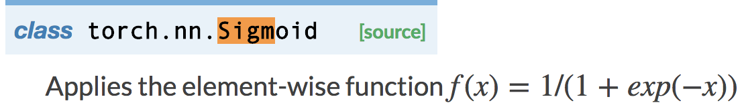
Logistic regression
Linear
Sigmoid
import torch.nn.functional as F
class Model(torch.nn.Module):
def __init__(self):
super(Model, self).__init__()
self.linear = torch.nn.Linear(1, 1)
def forward(self, x):
y_pred = F.sigmoid(self.linear(x))
return y_pred
Notes:
\hat{y}=x*w+b
loss = \frac{1}{N}\sum_{n=1}^{N} y^{(n)} \log \hat{y}^{(n)} + (1 - y^{(n)}) \log (1-\hat{y}^{(n})

Slide 14
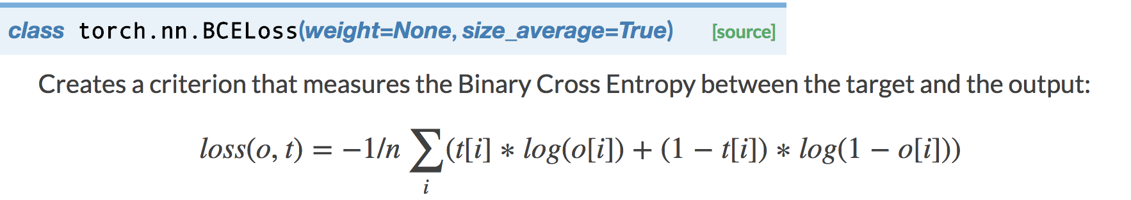
Logistic regression
Linear
Sigmoid
import torch.nn.functional as F
class Model(torch.nn.Module):
def __init__(self):
super(Model, self).__init__()
self.linear = torch.nn.Linear(1, 1)
def forward(self, x):
y_pred = F.sigmoid(self.linear(x))
return y_pred
criterion = torch.nn.BCELoss(size_average=True)
Notes:
\hat{y}=x*w+b
loss = \frac{1}{N}\sum_{n=1}^{N} y^{(n)} \log \hat{y}^{(n)} + (1 - y^{(n)}) \log (1-\hat{y}^{(n})

Slide 15
Logistic regression
x_data = Variable(torch.Tensor([[1.0], [2.0], [3.0], [4.0]]))
y_data = Variable(torch.Tensor([[0.], [0.], [1.], [1.]]))
class Model(torch.nn.Module):
def __init__(self):
super(Model, self).__init__()
self.linear = torch.nn.Linear(1, 1) # One in and one out
def forward(self, x):
y_pred = F.sigmoid(self.linear(x))
return y_pred
# our model
model = Model()
criterion = torch.nn.BCELoss(size_average=True)
optimizer = torch.optim.SGD(model.parameters(), lr=0.01)
# Training loop
for epoch in range(1000):
# Forward pass: Compute predicted y by passing x to the model
y_pred = model(x_data)
# Compute and print loss
loss = criterion(y_pred, y_data)
print(epoch, loss.data[0])
# Zero gradients, perform a backward pass, and update the weights.
optimizer.zero_grad()
loss.backward()
optimizer.step()
# After training
hour_var = Variable(torch.Tensor([[1.0]]))
print("predict 1 hour ", 1.0, model(hour_var).data[0][0] > 0.5)
hour_var = Variable(torch.Tensor([[7.0]]))
print("predict 7 hours", 7.0, model(hour_var).data[0][0] > 0.5)
Notes:
\hat{y}=x*w+b
loss = \frac{1}{N}\sum_{n=1}^{N} y^{(n)} \log \hat{y}^{(n)} + (1 - y^{(n)}) \log (1-\hat{y}^{(n})

Slide 16

Logistic regression
x_data = Variable(torch.Tensor([[1.0], [2.0], [3.0], [4.0]]))
y_data = Variable(torch.Tensor([[0.], [0.], [1.], [1.]]))
class Model(torch.nn.Module):
def __init__(self):
super(Model, self).__init__()
self.linear = torch.nn.Linear(1, 1) # One in and one out
def forward(self, x):
y_pred = F.sigmoid(self.linear(x))
return y_pred
# our model
model = Model()
criterion = torch.nn.BCELoss(size_average=True)
optimizer = torch.optim.SGD(model.parameters(), lr=0.01)
# Training loop
for epoch in range(1000):
# Forward pass: Compute predicted y by passing x to the model
y_pred = model(x_data)
# Compute and print loss
loss = criterion(y_pred, y_data)
print(epoch, loss.data[0])
# Zero gradients, perform a backward pass, and update the weights.
optimizer.zero_grad()
loss.backward()
optimizer.step()
# After training
hour_var = Variable(torch.Tensor([[1.0]]))
print("predict 1 hour ", 1.0, model(hour_var).data[0][0] > 0.5)
hour_var = Variable(torch.Tensor([[7.0]]))
print("predict 7 hours", 7.0, model(hour_var).data[0][0] > 0.5)
Design your model using class
Linear
Sigmoid
Notes:
\hat{y}=x*w+b
loss = \frac{1}{N}\sum_{n=1}^{N} y^{(n)} \log \hat{y}^{(n)} + (1 - y^{(n)}) \log (1-\hat{y}^{(n})

Slide 17


Logistic regression
x_data = Variable(torch.Tensor([[1.0], [2.0], [3.0], [4.0]]))
y_data = Variable(torch.Tensor([[0.], [0.], [1.], [1.]]))
class Model(torch.nn.Module):
def __init__(self):
super(Model, self).__init__()
self.linear = torch.nn.Linear(1, 1) # One in and one out
def forward(self, x):
y_pred = F.sigmoid(self.linear(x))
return y_pred
# our model
model = Model()
criterion = torch.nn.BCELoss(size_average=True)
optimizer = torch.optim.SGD(model.parameters(), lr=0.01)
# Training loop
for epoch in range(1000):
# Forward pass: Compute predicted y by passing x to the model
y_pred = model(x_data)
# Compute and print loss
loss = criterion(y_pred, y_data)
print(epoch, loss.data[0])
# Zero gradients, perform a backward pass, and update the weights.
optimizer.zero_grad()
loss.backward()
optimizer.step()
# After training
hour_var = Variable(torch.Tensor([[1.0]]))
print("predict 1 hour ", 1.0, model(hour_var).data[0][0] > 0.5)
hour_var = Variable(torch.Tensor([[7.0]]))
print("predict 7 hours", 7.0, model(hour_var).data[0][0] > 0.5)
Design your model using class
Linear
Sigmoid
Construct loss and optimizer (select from PyTorch API)
Training cycle
(forward, backward, update)
Notes:
\hat{y}=x*w+b
loss = \frac{1}{N}\sum_{n=1}^{N} y^{(n)} \log \hat{y}^{(n)} + (1 - y^{(n)}) \log (1-\hat{y}^{(n})

Slide 18
Logistic regression
x_data = Variable(torch.Tensor([[1.0], [2.0], [3.0], [4.0]]))
y_data = Variable(torch.Tensor([[0.], [0.], [1.], [1.]]))
class Model(torch.nn.Module):
def __init__(self):
super(Model, self).__init__()
self.linear = torch.nn.Linear(1, 1) # One in and one out
def forward(self, x):
y_pred = F.sigmoid(self.linear(x))
return y_pred
# our model
model = Model()
criterion = torch.nn.BCELoss(size_average=True)
optimizer = torch.optim.SGD(model.parameters(), lr=0.01)
# Training loop
for epoch in range(1000):
# Forward pass: Compute predicted y by passing x to the model
y_pred = model(x_data)
# Compute and print loss
loss = criterion(y_pred, y_data)
print(epoch, loss.data[0])
# Zero gradients, perform a backward pass, and update the weights.
optimizer.zero_grad()
loss.backward()
optimizer.step()
# After training
hour_var = Variable(torch.Tensor([[1.0]]))
print("predict 1 hour ", 1.0, model(hour_var).data[0][0] > 0.5)
hour_var = Variable(torch.Tensor([[7.0]]))
print("predict 7 hours", 7.0, model(hour_var).data[0][0] > 0.5)
0 1.6369143724441528
1 1.6119738817214966
2 1.5872894525527954
3 1.5628681182861328
4 1.5387169122695923
5 1.514843225479126
6 1.4912540912628174
7 1.467956781387329
8 1.4449583292007446
9 1.4222657680511475
10 1.3998862504959106
...
…
988 0.39138174057006836
989 0.39128318428993225
990 0.39118456840515137
991 0.3910861015319824
992 0.39098766446113586
993 0.3908892273902893
994 0.39079099893569946
995 0.39069271087646484
996 0.3905944228172302
997 0.39049631357192993
998 0.39039820432662964
999 0.3903001546859741
predict 1 hour 1.0 False
predict 7 hours 7.0 True
Notes:
\hat{y}=x*w+b
loss = \frac{1}{N}\sum_{n=1}^{N} y^{(n)} \log \hat{y}^{(n)} + (1 - y^{(n)}) \log (1-\hat{y}^{(n})

Slide 19
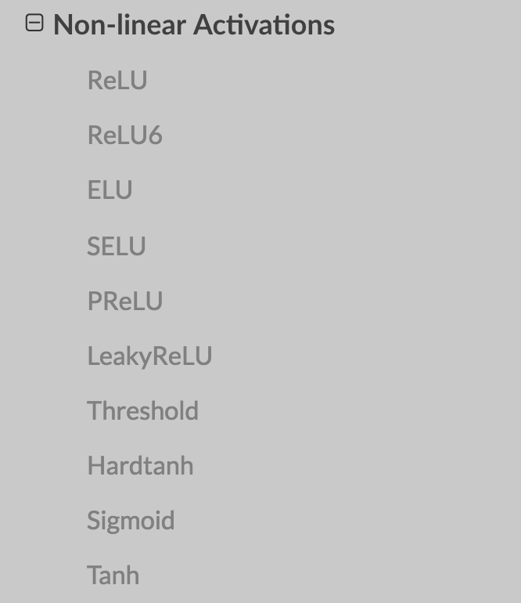
Exercise 6-1: Try other activation functions
Linear
Sigmoid

Slide 20


Lecture 7:
Wide and Deep

Slide 21
Backup slides

Slide 22
Building fun models
Neural Net components
CNN
RNN
Activations
Losses
Optimizers

Slide 23
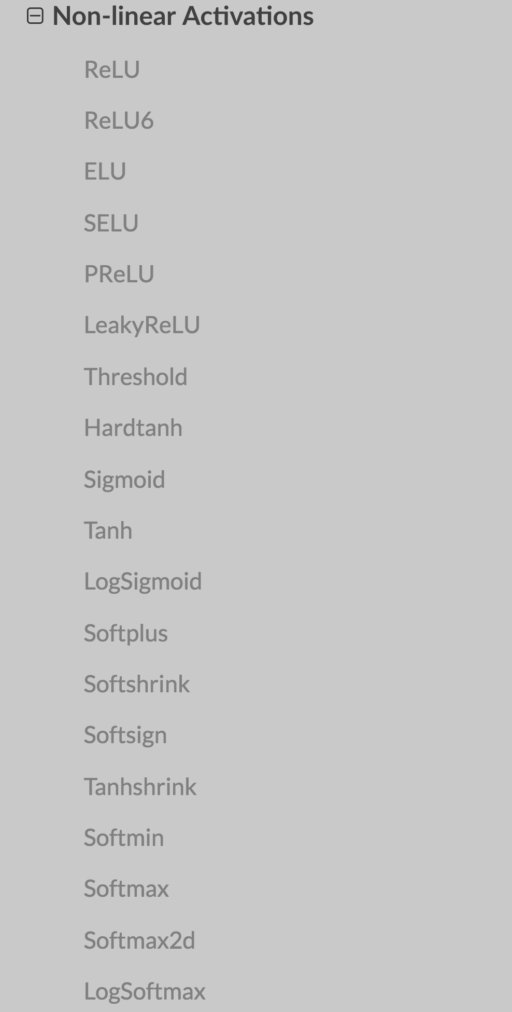
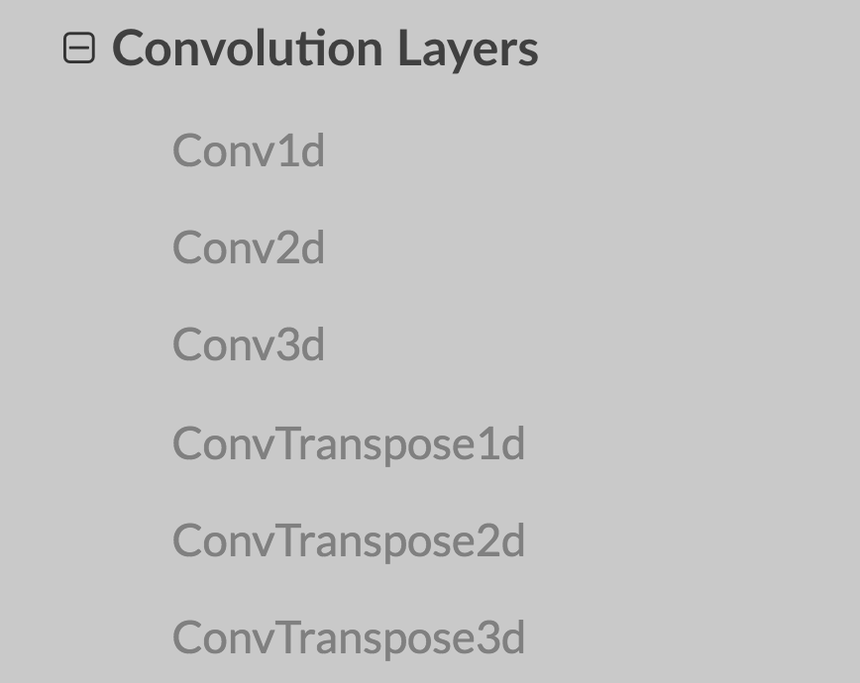

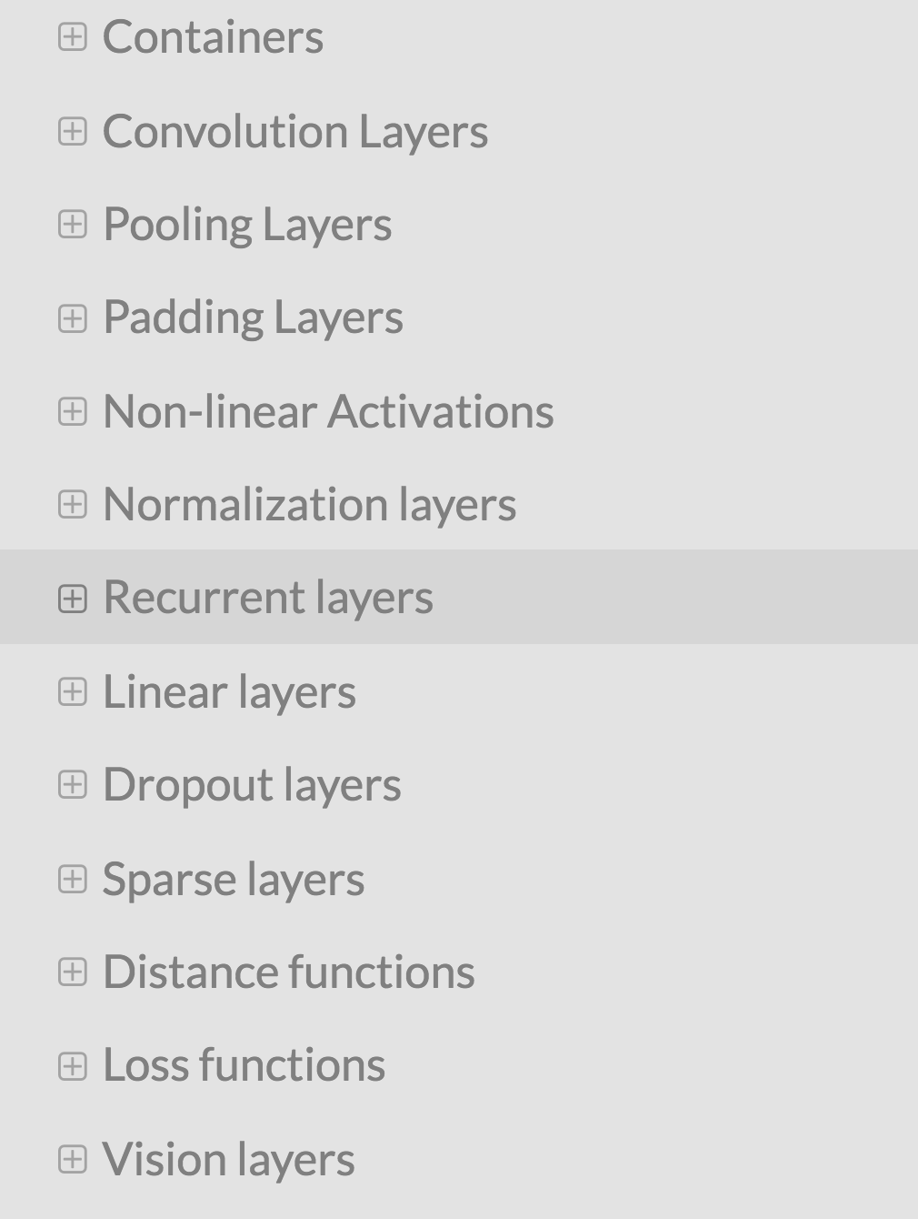
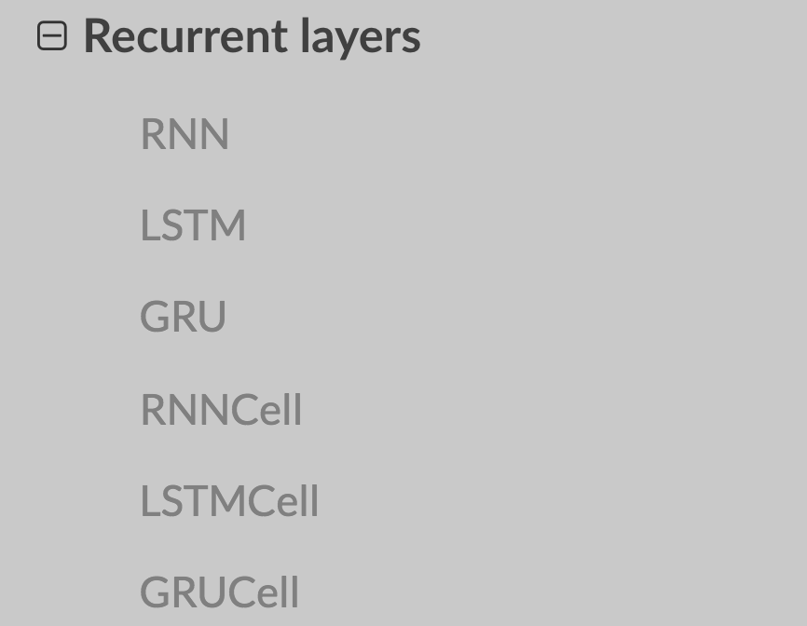
torch.nn
http://pytorch.org/docs/master/nn.html

Slide 24
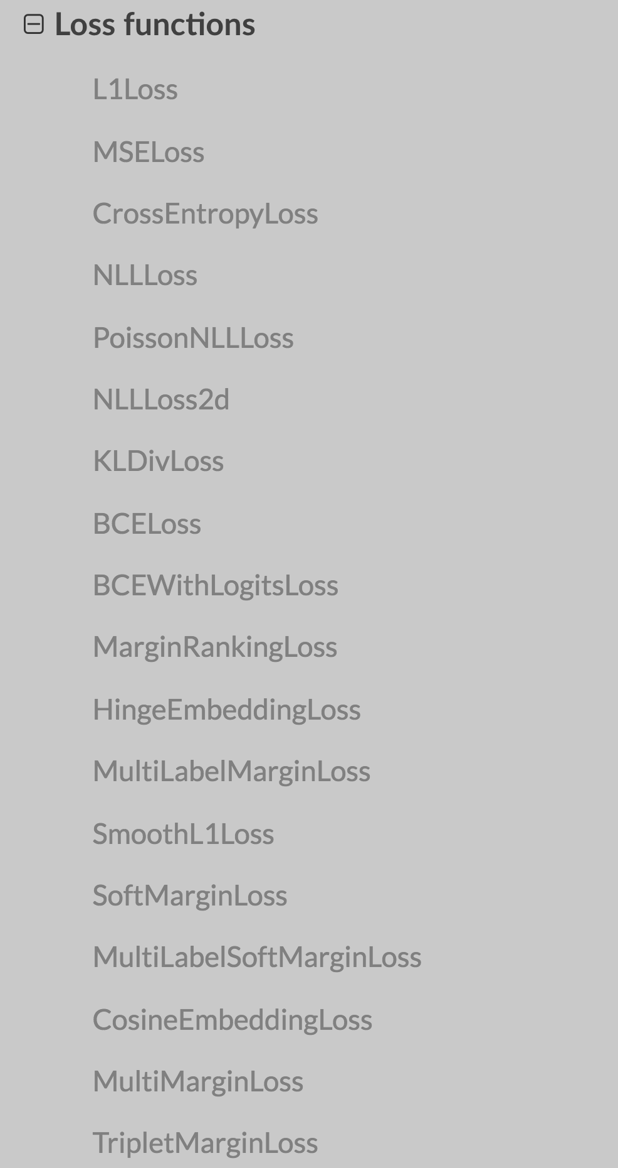
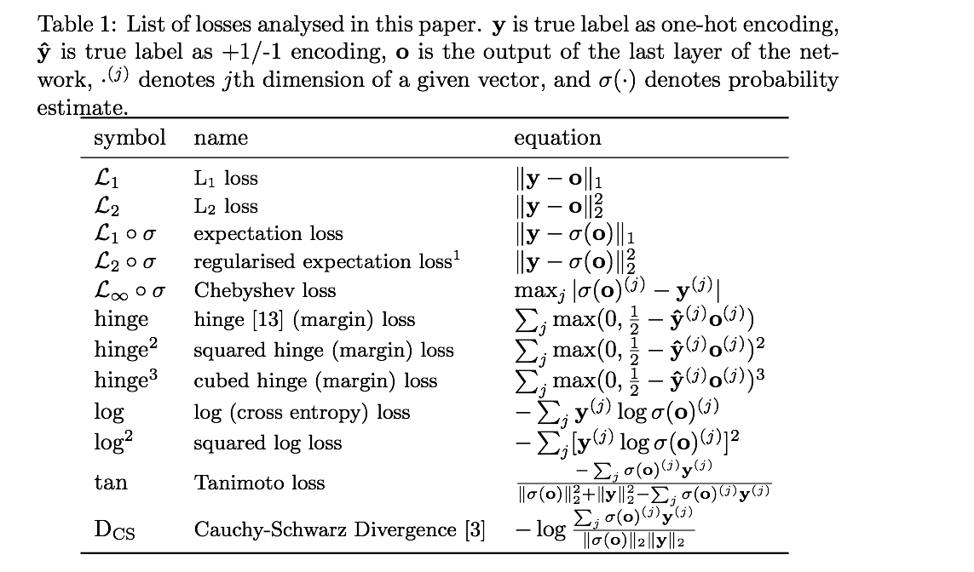
Loss functions
https://arxiv.org/pdf/1702.05659.pdf
http://pytorch.org/docs/master/nn.html

Slide 25
torch.optim
classtorch.optim.Adadelta
classtorch.optim.Adagrad
classtorch.optim.Adam
classtorch.optim.Adamax
classtorch.optim.ASGD
classtorch.optim.RMSprop
classtorch.optim.Rprop
classtorch.optim.SGD
http://pytorch.org/docs/master/optim.html

Slide 26
Three simple steps
Design your model using class
Construct loss and optimizer
(select from PyTorch API)
Training cycle
(forward, backward, update)

Slide 27
Exercise 6-1
Try different optimizers

Slide 28
Lecture 7:
Wide and Deep

